Slide 1
Successive

Slide 2
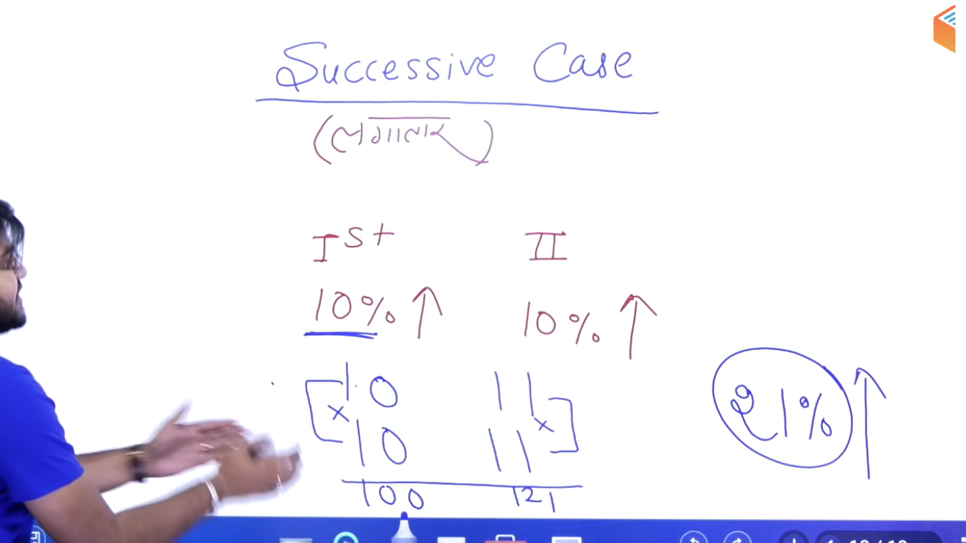

Slide 3
